Slide 1
NextGenCart: Shopping Made Smart and Simple
Team Number 10
Shrinidhi Mudhole 01FE22BAR015
Nandeesh B Tuppad 01FE22BAR020
Vijay Totakar 01FE22BAR023
Shwetha S Halepujari 01FE22BAR042
Koushik 01FE23BAR413

Slide 2
Contents
Problem statement
Pertinent information
Literature survey/review
Problem analysis
Questionnaire for stakeholders
Requirements
Use case scenarios
Specifications/Functions
MATLAB Requirement tool box
Analysis of Existing Products
Identification of Similarities & differences of functionalities
Identification of Similarities & differences of entities
Conceptual design

Slide 3
Contents
Function tree
FBS Model
Multidisciplinary Product Decomposition
Product Architecture
Virtual model
Mathematical model
Simulation
Mechanical Design – Dynamics calculations
Control system design – System work flow
Software design – MATLAB System composer logical architecture
Electrical design – Power calculations (Battery/Adapter sizing)
Electronics design – Circuit design
User on prototype
NPS Score

Slide 4
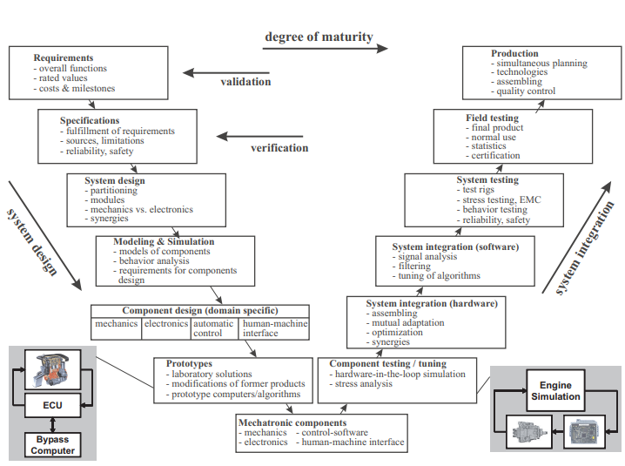
The VDI2206 Process

Slide 5
Requirements collection & Writing Specifications Research for User Needs

Slide 6
Problem statement
Problem statement: Long queues and manual checkout processes in supermarkets cause delays and inconvenience. Our project aims to develop a smart shopping cart with automatic billing providing a faster, hands-free and seamless shopping experience.
2. Revised problem statement:
Long queues and manual checkouts in supermarkets cause delays and inconvenience. Our project introduces a smart shopping cart with automatic billing providing a faster and seamless experience. This smart cart not only enhances convenience but also benefits stores by reducing reliance on manual barcode scanning. By enabling automatic item detection and billing, it aligns with modern retail innovations and transforms the shopping experience.

Slide 7
Pertinent information
The Smart Shopping Cart enhances shopping by autonomously following customers and performing automatic billing. It identifies items as they’re added, instantly updating the customer’s virtual shopping list. Sensors help the cart to maintain a safe distance from the customer and avoid obstacles. A microcontroller manages navigation and data processing, streamlining the shopping experience. This reduces checkout times and increases convenience in retail environments.
Major Stakeholders and Needs for Smart shopping cart are:
1.Hand impaired person
2.Carrying women
3.Old people
4.Shopping mart manager and workers.

Slide 8
Pertinent information
Tools and Technologies :
Embedded Systems (STM32)
Ultrasonic Sensors
Motor Drivers and DC Motors
Power Supply (Batteries).
RFID (Radio Frequency Identification)
Components :
STM32 Microcontroller
RFID Reader and Tags
Motors
Motor Driver
Ultrasonic or IR Sensors
Display Screen
Battery.

Slide 9
Pertinent information
Software :
Programming IDE (STM32CubeIDE, Arduino IDE)
Embedded C/C++ or Micro python
RFID Library
Motor Control Library
Sensor Libraries (Ultrasonic/IR)
Mathematical Models:
PID Control Algorithm
Path Planning Algorithms
Distance Calculation
Power Consumption Models

Slide 10
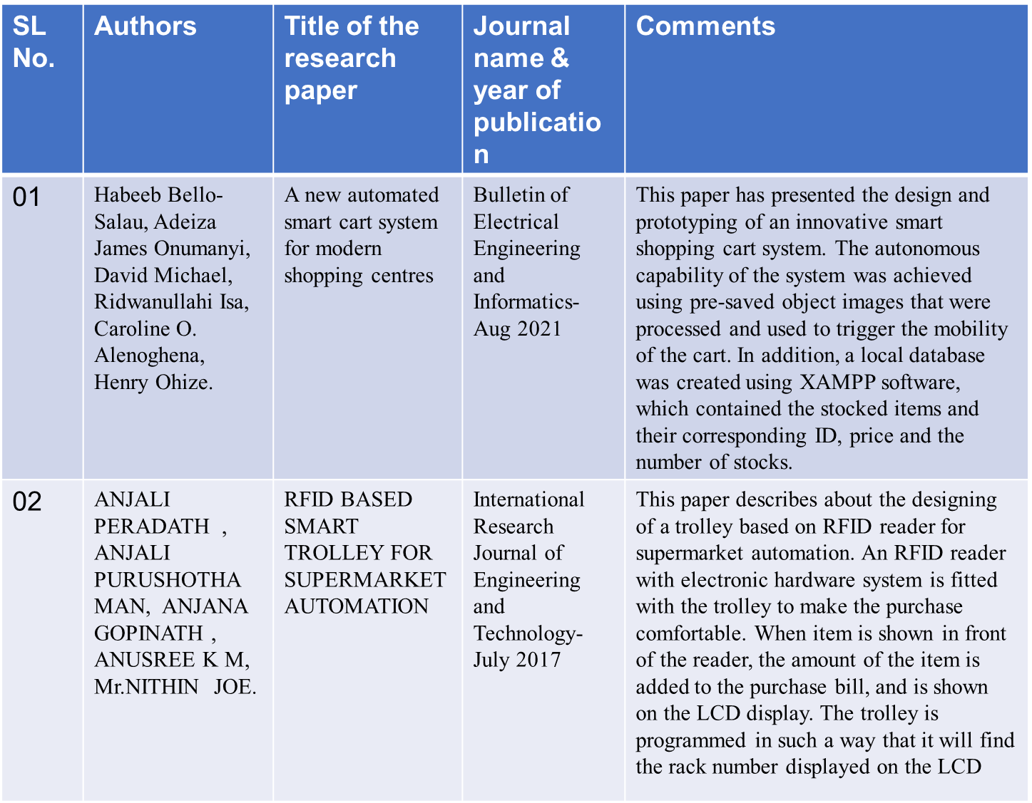
Literature survey/review

Slide 11
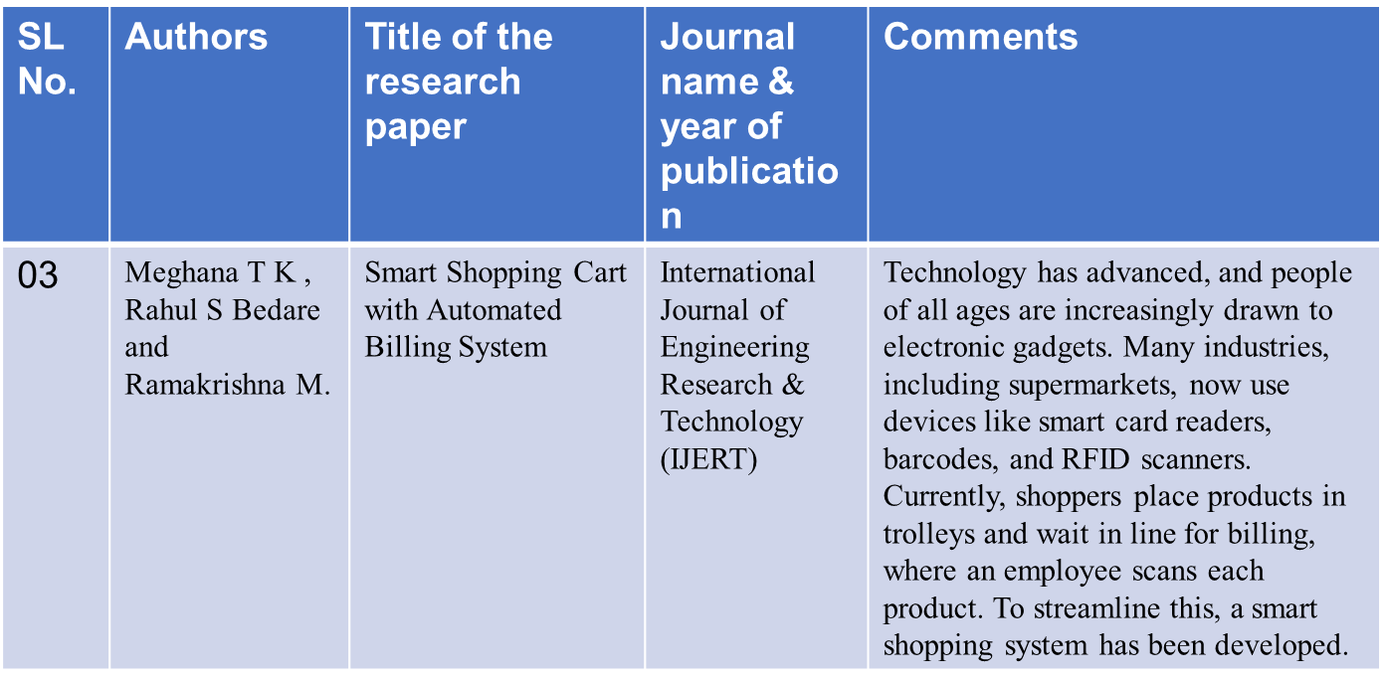
Literature survey/review

Slide 12
Questionnaire for stakeholders
Question 1: What specific features do you believe are most important for the Smart Shopping Cart?
Ans : Key features include automatic item tracking, real-time billing, obstacle avoidance, user-friendly interface.
Question 2: Would a smart cart that follows you and reduces physical strain enhance your shopping experience?
Answer: Yes, it would make shopping easier by reducing the need to push a heavy cart, making it more comfortable for longer shopping trips.
Question 3: How important is it for the cart to stop automatically if something unexpected happens?
Answer: Very important; safety is a top priority, especially in crowded spaces.

Slide 13
Questionnaire for stakeholders
Question 4: How do you feel about automated billing systems, which reduce waiting times at checkout?
Answer: That would be highly convenient, especially avoiding long queues.
Question 5: How would a smart shopping cart change the way you assist customers?
Answer: It would reduce the need for manual assistance, allowing me to focus on other tasks.
Question 6: Do you expect the carts to reduce waiting times at checkout?
Answer: Definitely, automated billing could significantly reduce checkout lines.
Question 7: Do you think this technology could make your shopping experience faster and more enjoyable?
Answer: Absolutely, especially with less physical strain and shorter checkout processes

Slide 14
Questionnaire for stakeholders
Question 8: How do you perceive the potential impact of the smart shopping cart on the retail industry?
Answer: It could revolutionize customer interactions and improve shopping efficiency significantly.
Question 9: What challenges do you foresee in implementing this technology?
Answer: Integrating technology in a user-friendly way and ensuring safety during operation will be major challenges.
Question 10: What features do you think are essential for the smart shopping cart?
Answer: Essential features include cart movement, automatic billing, and safety mechanisms like emergency stops.

Slide 15
Problem analysis
After interacting with stakeholders concerning the use of smart shopping cart in shopping malls and stores, we have gained valuable insights that can help us guide the development and implementation of smart shopping cart. Here are some common understandings we have obtained:
Here are the main points summarized:
1. Customer Convenience: Minimize shopping hassles and reduce checkout time with real time billing.
2. Operational Efficiency: Improve store efficiency by reducing staff workload and streamlining inventory tracking.
3. Accuracy and Reliability: Ensure accurate item scanning and billing to maintain customer trust.
4. Safety and Navigation: Safely navigate the store, avoiding obstacles and maintaining safe distances.

Slide 16
Problem analysis
5. User-Friendly Interface: Provide an intuitive display for easy interaction and bill viewing.
6. Adaptability to Layouts: Adapt to various store layouts and handle high-traffic areas effectively.
7. Cost-Effectiveness: Balance innovation with affordability for implementation and maintenance.
8. Maintenance and Support: Ensure the system is low-maintenance with accessible support when needed.

Slide 17
Requirements
Requirements of stakeholders :
1 User Alerts and Notifications
Repeated Item Notification: The cart shall notify the customer if they add repeated items to the cart
Expired Product Detection: The cart shall identify expired products and alert the customer.
2. Energy and Efficiency
Energy Efficiency: The cart should be energy efficient to support extended shopping trips.
Autonomous following: The cart must operate completely hands-free so customers can focus on shopping.

Slide 18
Requirements
System requirements :
1. Energy and Efficiency
Energy Efficiency: The cart should be energy efficient to support extended shopping trips.
Low Maintenance: The cart should require minimal maintenance.
2. User Interface and Design
Large Display: The cart must have a large, clear display for ease of use.
Lighting Adjustment: The cart should adjust its lighting in dark or dimly lit sections of the store.

Slide 19
Requirements
Functional requirements :
1. Cart Following Mechanism
Customer Tracking: The cart must follow the customer.
Safe Distance Maintenance: The cart must maintain a safe distance from the customer during operation.
Speed Matching: The cart must automatically match the walking speed of the customer.
The cart must automatically stop when the customer stops
2. Item Detection and Billing
Automatic Item Identification: The cart must identify purchased items automatically.
Real-time Billing: The cart must show the total bill in real-time.
Item Removal: The cart must allow easy removal of unwanted items.

Slide 20
Requirements
Performance requirements :
1. Cart Following Mechanism
Safe Distance Maintenance: The cart must maintain a safe distance from the customer during operation.
Speed Matching: The cart must automatically match the walking speed of the customer.
2. User Alerts and Notifications
Proximity Alert: The cart must alert the user if they move far away from it.
Theft prevention: The cart shall alert when unauthorized item removal occurs.

Slide 21
Requirements
System technical requirements :
1. Structural and Design Considerations
Compact and Stable Design: The cart must be small enough to move around easily while staying stable.
Durable Materials: The cart must be made from materials that are light but still strong and long-lasting.
Modern Aesthetic: The cart must have a modern design that looks good and fits in with the store.
Organized Wiring: The wires and cables should be neatly hidden inside the cart to keep them organized and out of sight.

Slide 22
Use case scenarios
1. Customer Checkout Process : Customers pick up the Smart Shopping Cart, which scans items using RFID and displays the total cost. They can complete payment via a mobile app or directly on the cart.
2. Item Removal and Adjustment : When an item is removed, the cart automatically updates the total cost, ensuring accurate billing.
3. Obstacle Detection : Ultrasonic sensors enable the cart to detect obstacles, allowing it to stop or change direction for safety.
4. Inventory Management : The cart helps store staff manage inventory by updating the database in real time as items are added or removed.
5. Customer Assistance and Feedback : The cart can alert store staff to assist customers quickly, enhancing customer service.
6. Post-Purchase Experience : After checkout, customers leave the cart for automated return or cleaning, with purchase data sent back to the store for inventory planning.

Slide 23
Specifications/Functions
High-Level Requirements
1. Cart Following Mechanism
Customer Tracking
Safe Distance Maintenance
Speed Matching
2. Item Detection and Billing
Automatic Item Identification
Real-time Billing
Item Removal
3. User Alerts and Notifications
Proximity Alert
Repeated Item Notification

Slide 24
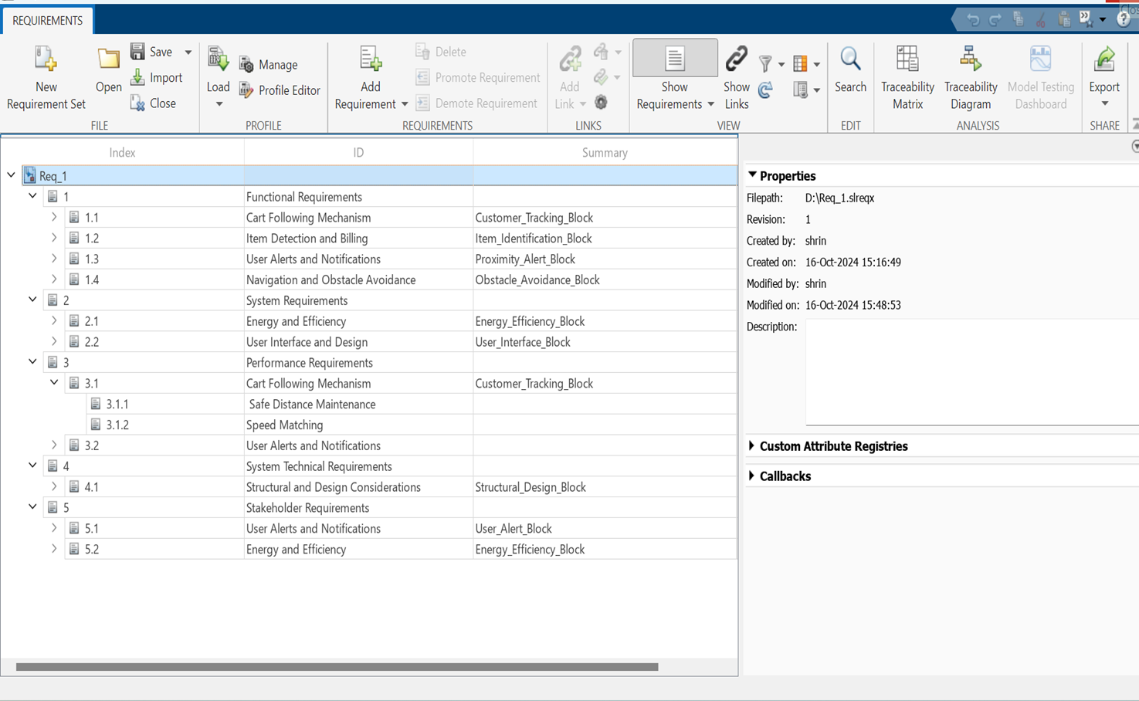
MATLAB Requirement tool box

Slide 25
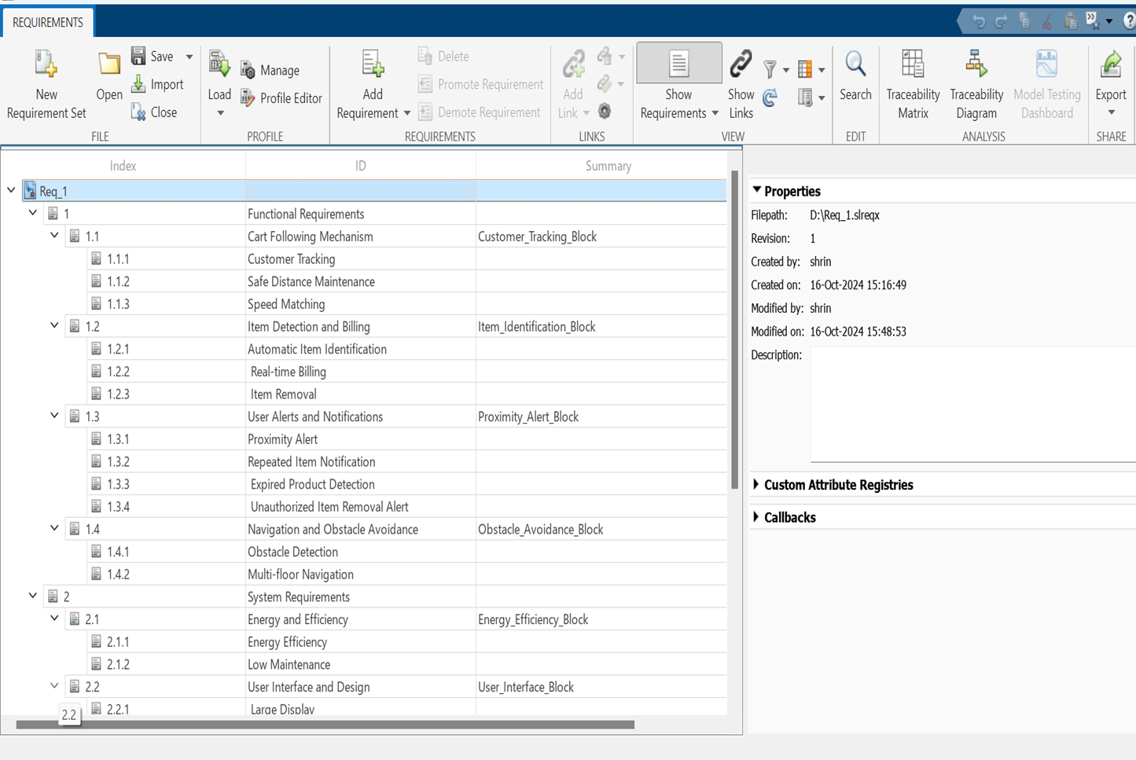
MATLAB Requirement tool box

Slide 26
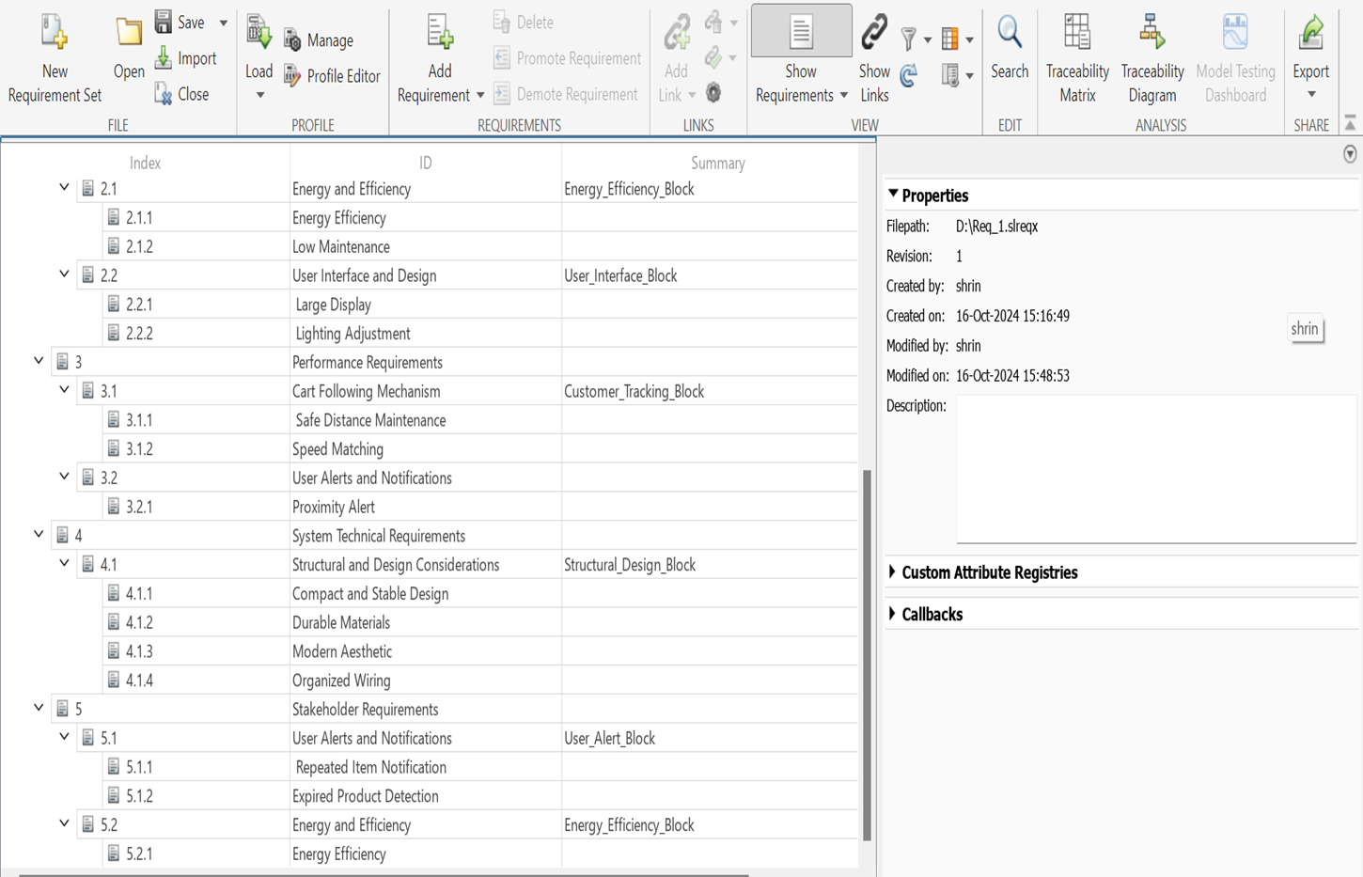
MATLAB Requirement tool box

Slide 27
System design Defining the architecture and interfaces

Slide 28
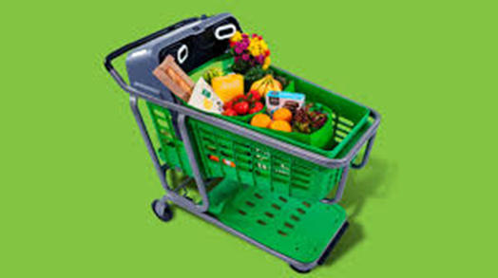
Analysis of Existing Products
Amazon Dash Cart.
Specifications:
Holds up to four grocery bags, doubling the capacity of earlier versions.
Weather-resistant to withstand outdoor conditions, making it more durable.
Real-time receipt display on the cart's screen.
Improved weight measurement system for precise produce weighing, including an algorithm that compensates for cart movement.

Slide 29
Analysis of Existing Products
Technical aspects like Actuators, and sensors used
Weight sensors.
Cameras(CV).
motion sensors.
Technology Used
Computer Vision
Sensor Fusion
QR Code Integration
Functionalities/Use Cases
Automatic Checkout
Produce Weight Measurement
Product Suggestions

Slide 30
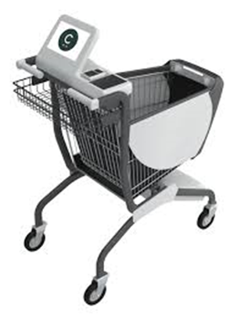
Analysis of Existing Products
2. Caper AI Cart
Specifications:
touchscreen interface for scanning and interacting with products.
Artificial Intelligence (AI) for identifying products automatically.

Slide 31
Analysis of Existing Products
Technical aspects like Actuators, and sensors used in it
Uses a combination of weight sensors and AI-driven cameras to detect items in the cart.
The cart’s movement is manually controlled, but it uses sensors for automatic adjustments.
Technology Used
AI & Computer Vision
Mobile App Integration
Functionalities/Use Cases
Item Recognition.
Checkout on Mobile.
Customer Interaction

Slide 32
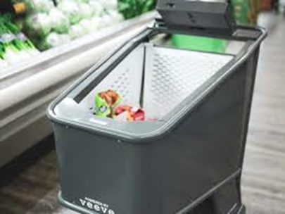
Analysis of Existing Products
3. Veeve Smart Cart
Specifications:
Payload: Standard grocery load (varies by store).
Speed: 2.0 m/s
Running Time: 12 hours on a Li-po battery.
Power Source: Li-po battery (rechargeable with swapping).
Location Tracking: Visual Positioning System (VPS) for store navigation.
Checkout: Contactless payments (EMV-certified).
Security: Loss prevention and item tracking.

Slide 33
Analysis of Existing Products
Technical aspects like Actuators, and sensors used in it
AI Cameras.
Visual Positioning System (VPS).
Proximity Sensors.
Motors for Cart Movement.
Technology Used
Visual Positioning System (VPS)
AI-Powered Cameras
Smart Battery Technology: Rechargeable Li-po batteries with a swapping mechanism
Contactless Payment System
Functionality
Automated Checkout, Personalized Shopping, Navigation Assistance, Weather-Resistant Design.

Slide 34
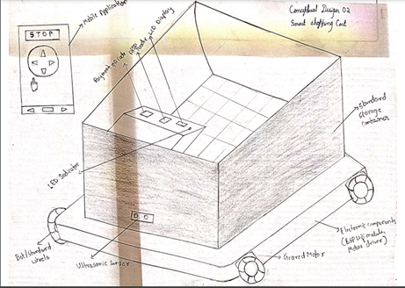
Analysis of Existing Products
4. Next Gen Cart
Specifications:
Controller: ESP32 microcontroller for system management.
Power Supply: Rechargeable battery (5V or 12V).
Connectivity: Wi-Fi/Bluetooth(Esp 32) for mobile app communication.
Display: LCD for item details and total bill.
Capacity: Designed to hold 10 kg.
Maximum Vehicle Speed : 15cm/s

Slide 35
Analysis of Existing Products
Technical aspects like Actuators, and sensors used in it
DC Motors for cart movement.
LED Indicator for duplicate item alerts.
Ultrasonic Sensor (e.g., HC-SR04) for obstacle detection.
RFID Reader (e.g., MFRC522) with tags for item scanning.
Technology Used
RFID: Scanning items for billing.
Mobile Application: Control cart movement and monitor status.
Wireless Communication: Wi-Fi/Bluetooth via ESP32.
Obstacle Detection: Ultrasonic sensor to stop the cart for safety.
Programming: Embedded C or Python for ESP32 logic.
Functionality
The smart shopping cart uses a mobile app for movement control, RFID for billing, and ultrasonic sensors for obstacle detection. It provides LED alerts for duplicate items and real-time status updates via the app and LCD.

Slide 36
Analysis of Existing Products
STEP 1 | ANALYSIS OF MULTIPLE AUTOMATIC GUIDED VEHICLE
a. | Functional analysis of all system | Amazon Dash Cart, Caper AI Cart, and Veeve Smart Cart all enable automated checkout but differ in functionality: Amazon integrates real-time receipts, Caper uses a touchscreen with mobile checkout, and Veeve adds navigation with VPS.
b. | Identification of functional differences | Amazon offers seamless checkout with weight sensors, Caper focuses on touchscreen and mobile payments, and Veeve features navigation, personalized shopping, and a rechargeable battery
c. | Physical analysis of all system | Amazon and Caper use standard cart designs with sensors, while Veeve includes AI cameras, VPS, and a rechargeable battery for enhanced features and longer use.
d. | Difference in physical level of smart shopping systems | Amazon is compact and durable, Caper focuses on interactivity, and Veeve combines advanced navigation and battery systems for extended functionality.
36

Slide 37
Identification of Similarities & differences of functionalities
Common functionalities of smart shopping cart
Item Detection: Uses RFID tags and ultrasonic sensors to automatically track items in the cart​
Automated Checkout: QR code scanning for quick, contactless checkout via the mobile app​.
Personalized Experience: Real-time location-based offers, promotions, and personalized recommendations.
Mobile App Integration: App control for cart movement, item tracking, and payment management.

Slide 38
Identification of Similarities & differences of functionalities
FUNCTION | SUB-FUNCTION | System1 | System 2 | System3 | System 4
Navigate | Obstacle detection | No | No | No | Yes
 | Obstacle avoidance | No | No | No | Yes
RFID-Based Item Scanning | Read RFID | No | No | No | Yes
 | Update Bill | Yes | Yes | Yes | Yes
 | Detect Duplicate item | Yes | Yes | Yes | Yes
Item Display on LCD | Update LCD | No | No | No | Yes
 | Display Total Bill | Yes | Yes | Yes | Yes
Cart Movement Control | Start / Stop Cart | No | No | No | Yes
 | Emergency Stop | No | No | No | Yes
 | Display Status | No | No | No | Yes

Slide 39
Identification of Similarities & differences of entities
Sl.No | Features | System 1 | System 2 | System 3 | System 4
1. | Payload Capacity | Holds up to four grocery bags | Standard grocery cart size | Standard grocery load (varies by store) | 10 kg
2. | Durability | Weather-resistant | Water & dust resistant | Weather-resistant | Dust & Weather resistant
3. | Power Source | Lead acid battery | Li-ion battery | Rechargeable Li-po battery (12-hour runtime) | Li-ion battery
4. | Checkout System | Automatic checkout with real-time receipt display | Mobile app-based checkout | Contactless payments (EMV-certified) | RFID & QR code based
5. | Technology Used | Computer Vision, Sensor Fusion, QR Code Integration | AI & Computer Vision, Mobile App Integration | VPS, AI-powered cameras, Smart Battery Technology | ESP32 mc,RFID technology, Ultrasonic sensor.
6. | Key Functionalities | Produce weighing, product suggestions, real-time receipt display | Item recognition, mobile checkout, interaction | Navigation, loss prevention, personalized shopping | Cart Movement, RFID Billing, Obstacle Detection, Cart Status
7. | Customer Interaction | Screen for receipt display | Touchscreen for product interaction | Navigation and personalized shopping | User-friendly app, real-time status, intuitive navigation.

Slide 40

Conceptual design

Slide 41
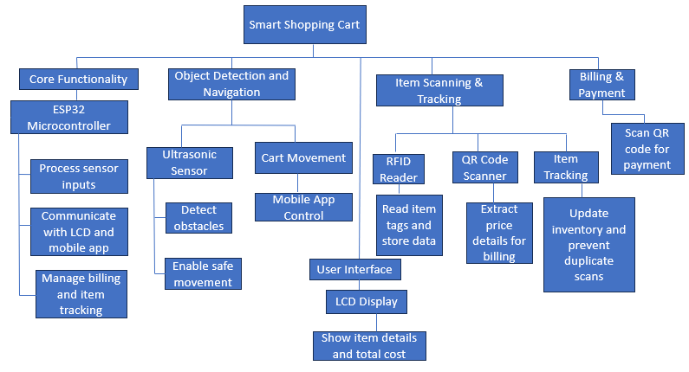
Function tree

Slide 42
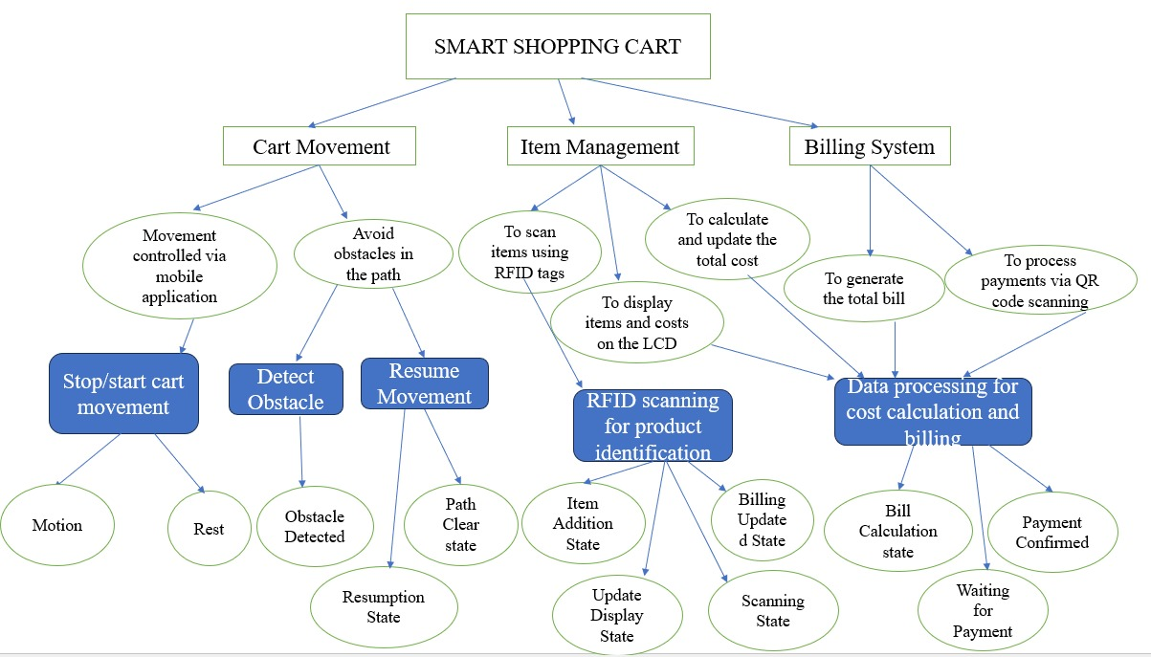
FBS Model

Slide 43
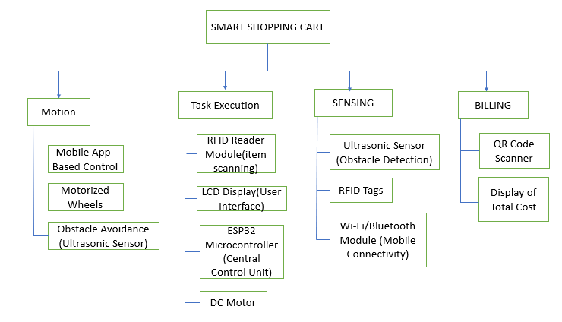
Multidisciplinary Product Decomposition and Structure Analysis

Slide 44
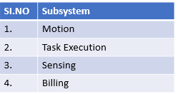
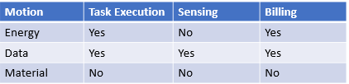
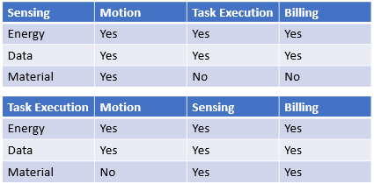
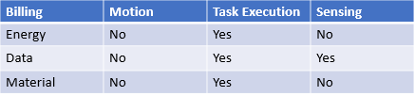
Multidisciplinary Product Decomposition and Structure Analysis
Subsystems
Interaction between Subsystems

Slide 45
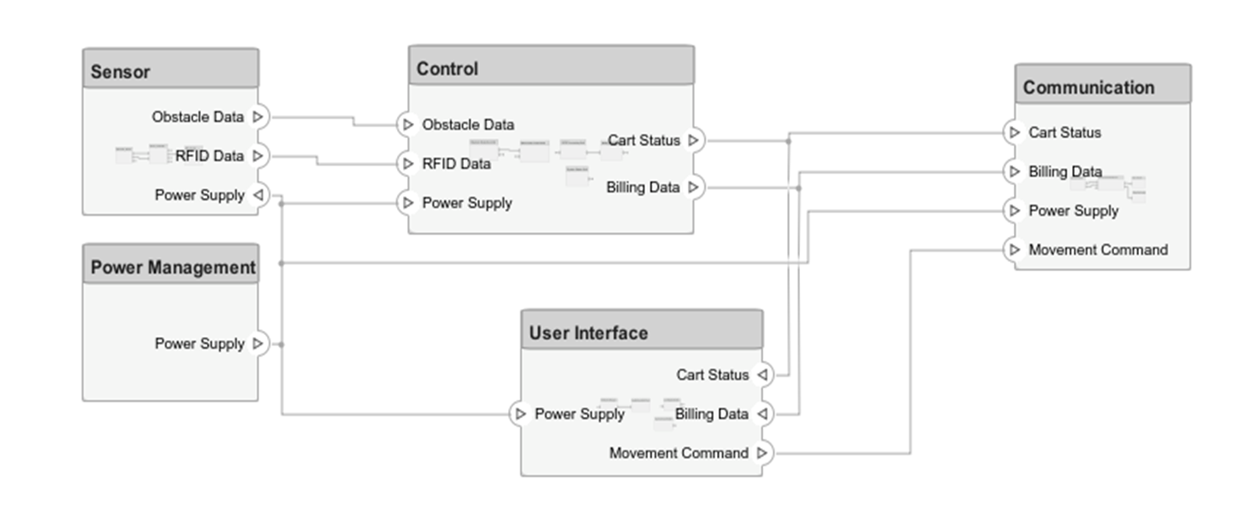
Product Architecture
Logical Architecture

Slide 46
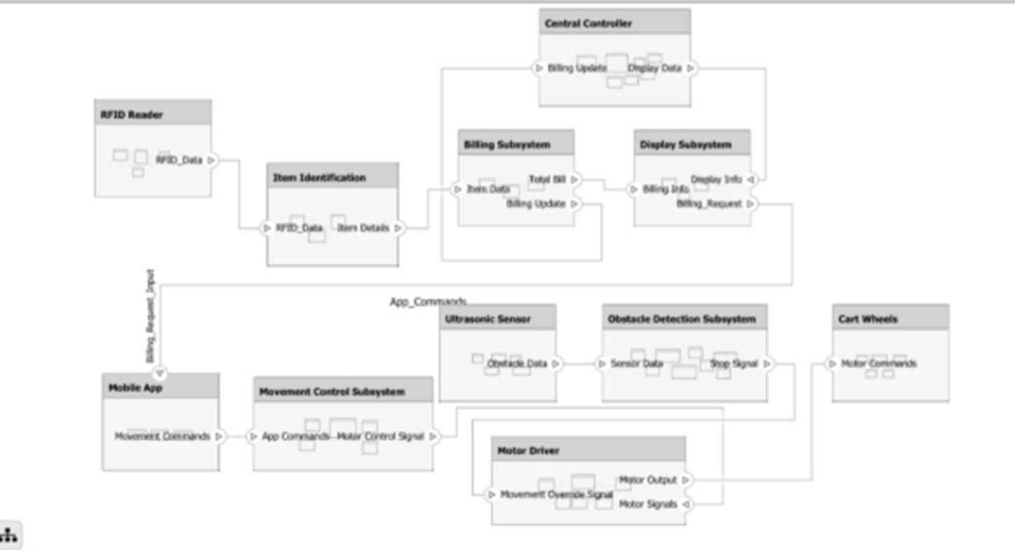
Product Architecture
Functional Architecture

Slide 47
Modelling & Simulation

Slide 48
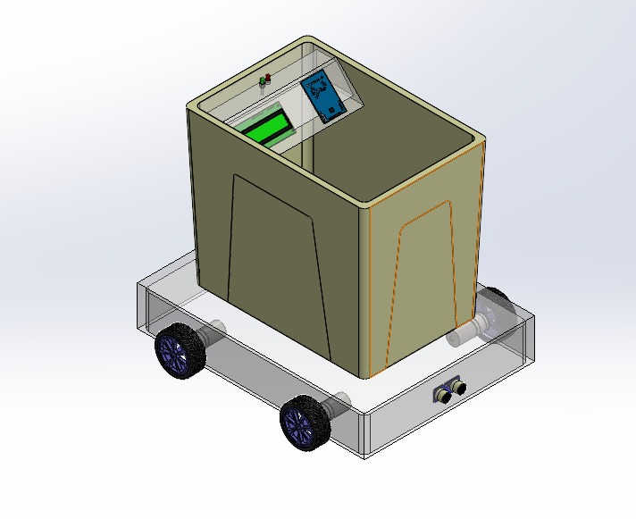
Virtual model

Slide 49
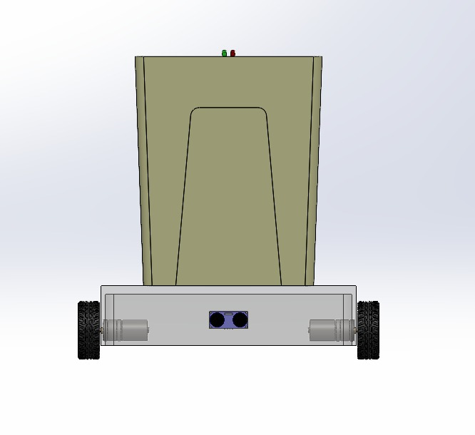
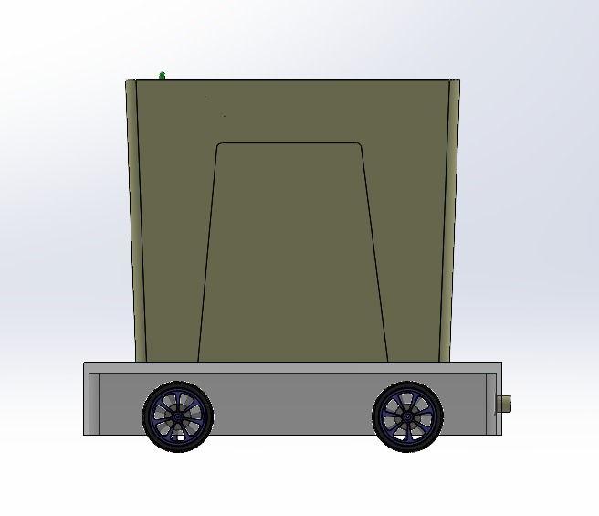
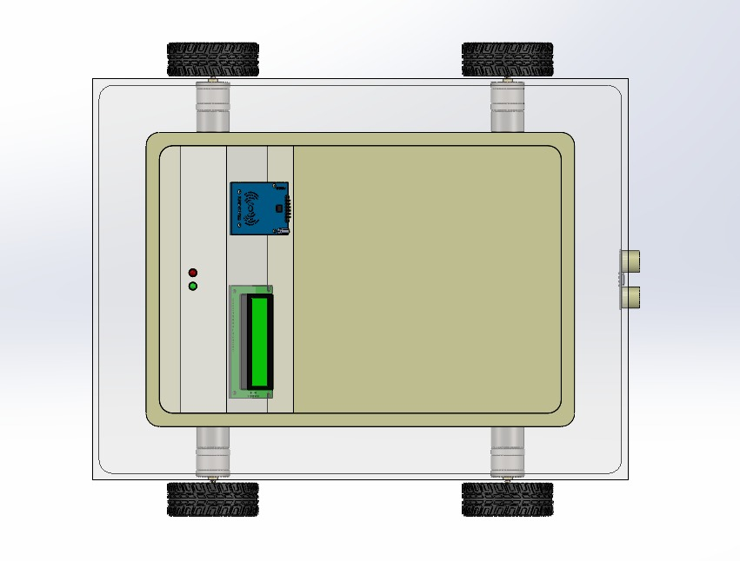
Virtual model
Front view
Side view
Top view

Slide 50
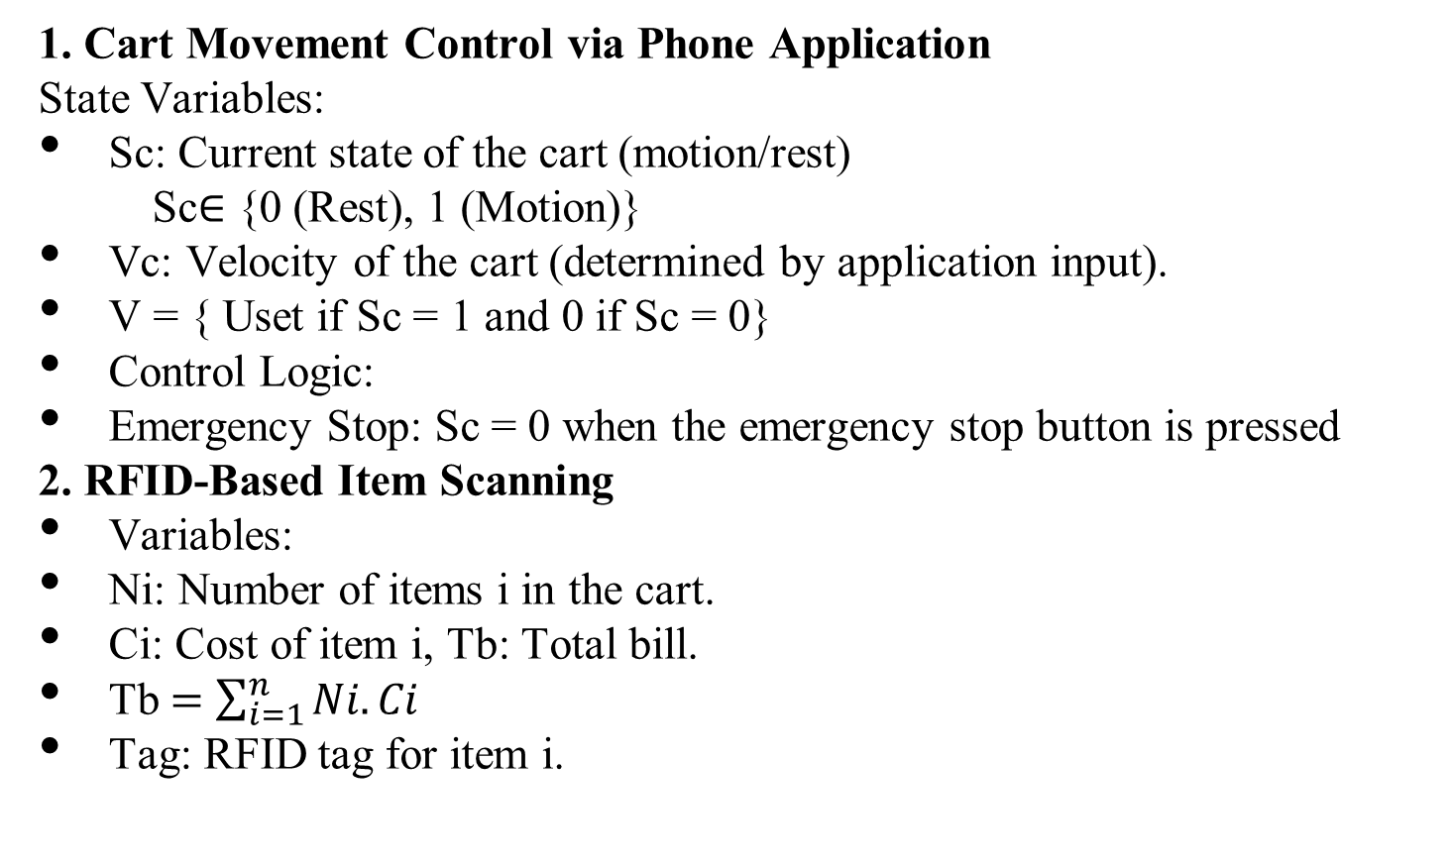
Mathematical model
1. Cart Movement Control via Phone Application
State Variables:
Sc: Current state of the cart (motion/rest)
Sc∈ {0 (Rest), 1 (Motion)}
Vc: Velocity of the cart (determined by application input).
V = { Uset if Sc = 1 and 0 if Sc = 0}
Control Logic:
Emergency Stop: Sc = 0 when the emergency stop button is pressed
2. RFID-Based Item Scanning
Variables:
Ni: Number of items i in the cart.
Ci: Cost of item i, Tb: Total bill.
Tb $=\sum_{i=1}^{n}{Ni.Ci}$
Tag: RFID tag for item i.

Slide 51
Mathematical model
3. LED Indicator
If Ni 1 for an item:
LED; = 1 (Turn ON the LED)
4. Obstacle Detection
Sensor Reading:
d: Distance to the obstacle measured by the ultrasonic sensor.
dmin: Minimum safe distance.
Obstacle Detection Logic:
Sc=0 if d< or = dmin
5. Item Display on LCD
Item Details:
LCD Display = {Item Name, Cost, Quantity}
Updates
dynamically upon scanning a new item i.

Slide 52
Mathematical model
6. System Control Inputs
Control inputs :
Ua: Application commands (e.g., start, stop, velocity).
Us: Sensor feedback (e.g., obstacle detection).
Ur​: RFID inputs.
System Dynamics:
The ESP32 microcontroller processes inputs and sets the cart’s state and velocity:
Sc=f(Ua,Us), Vc=g(Ua)

Slide 53
Simulation
MATLAB/ROS/Rviz etc. Simulation.
You can insert the videos here or else you can show directly in the software itself.

Slide 54
Components Design Domain specific design

Slide 55
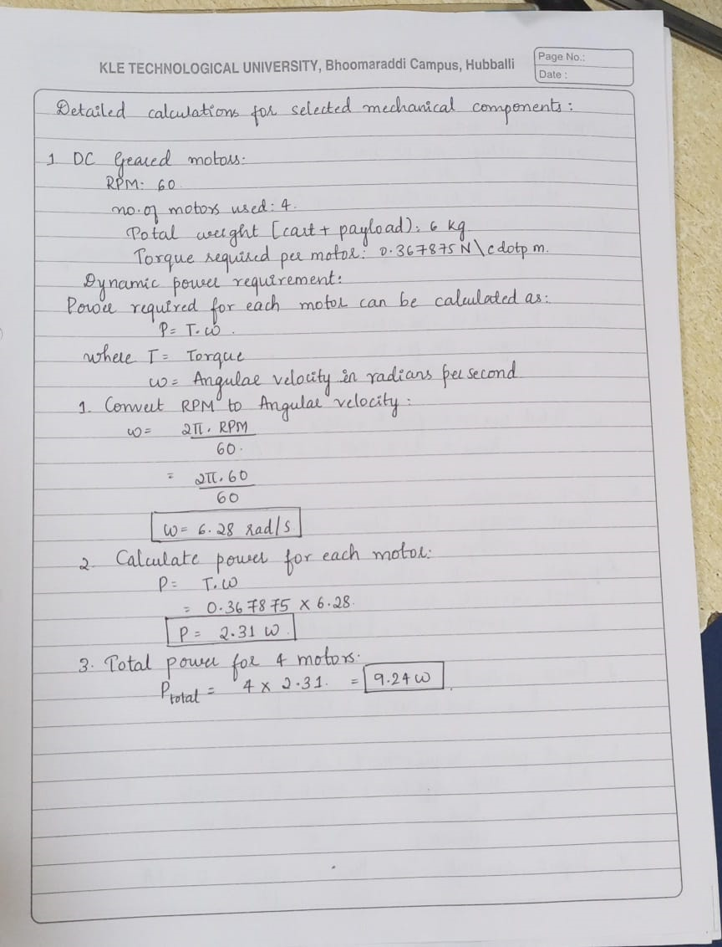
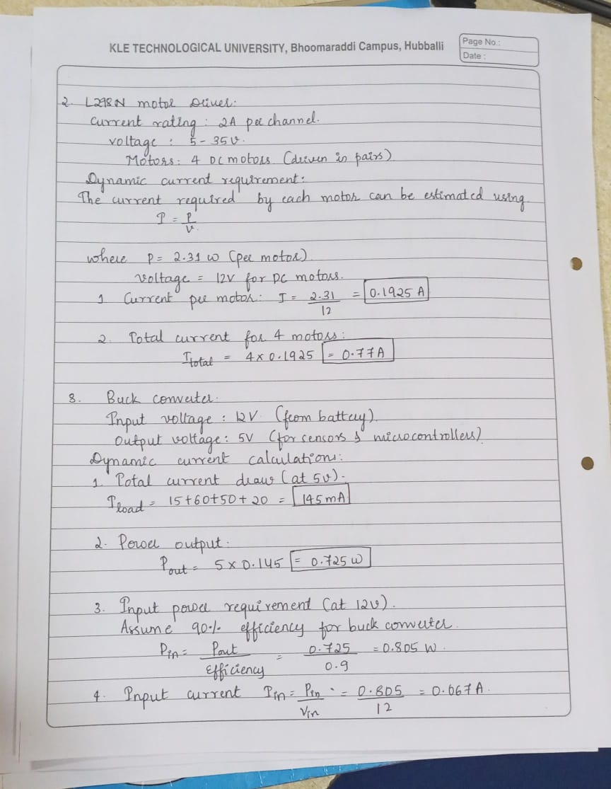
Mechanical Design

Slide 56
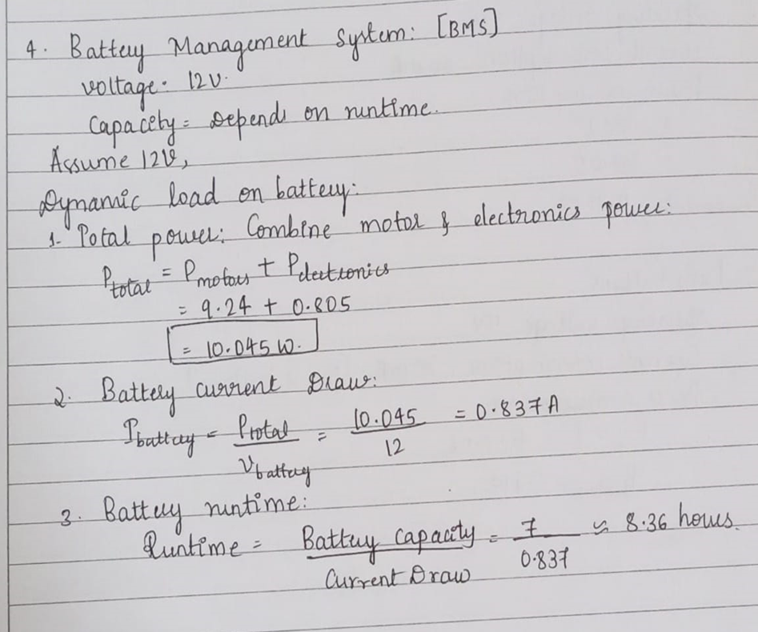
Mechanical Design

Slide 57
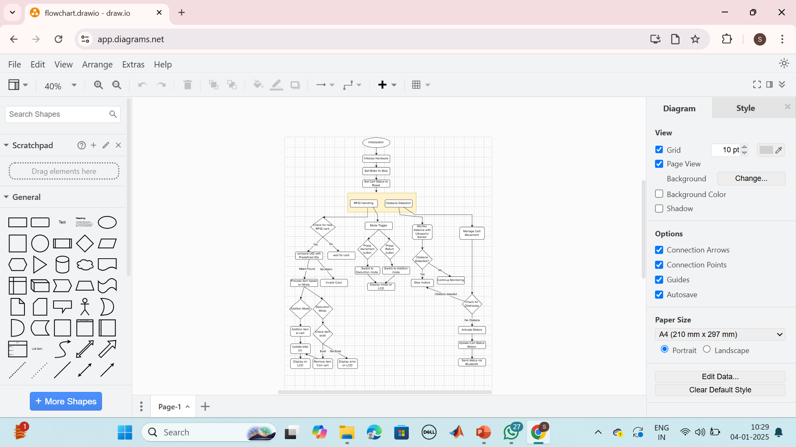
Control system design

Slide 58
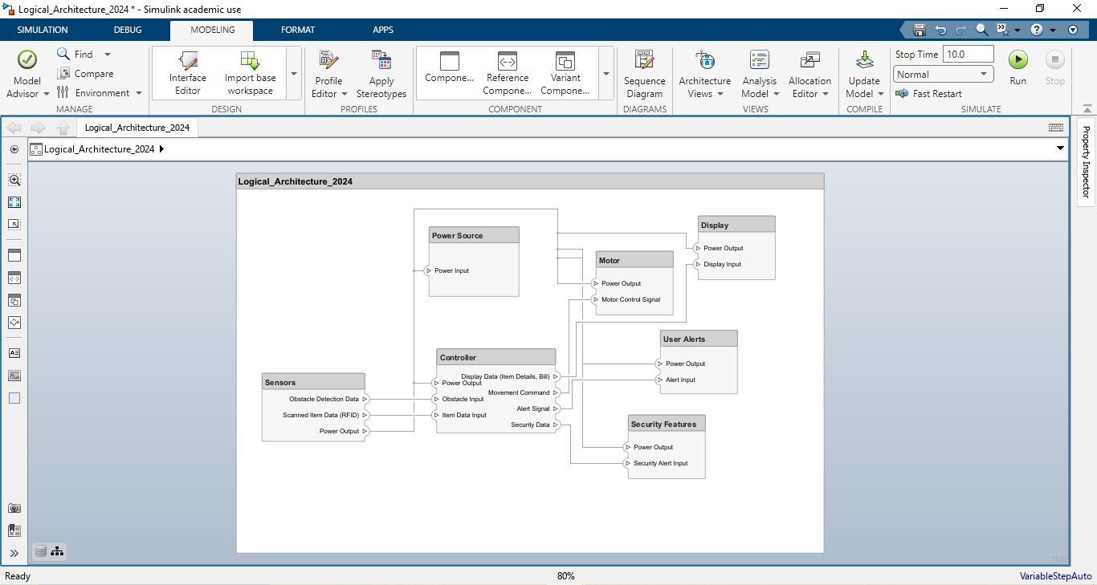
Software design
Logical Architecture

Slide 59
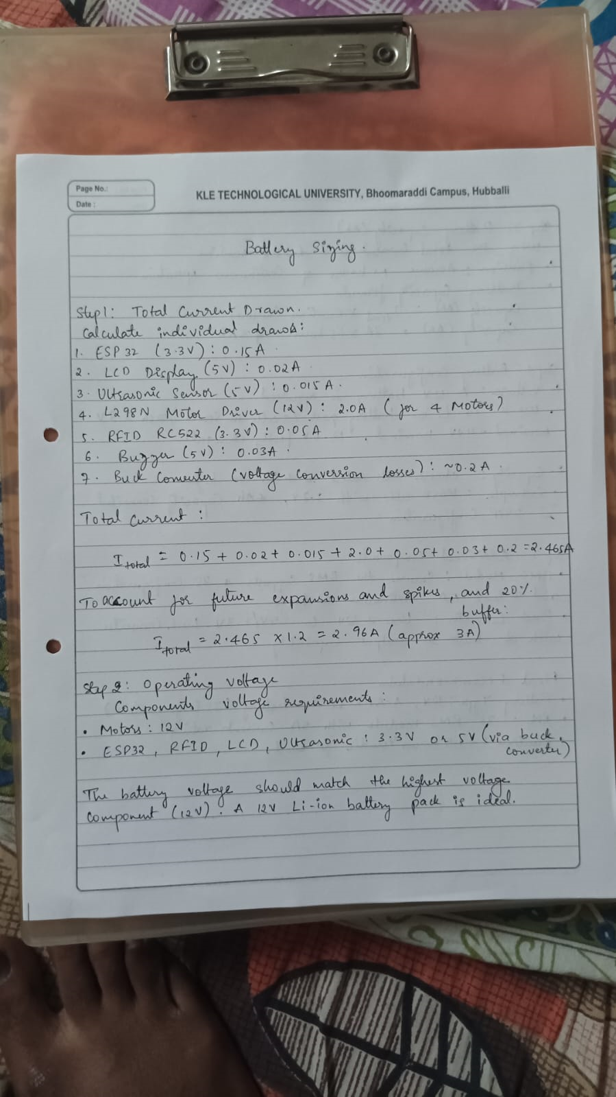
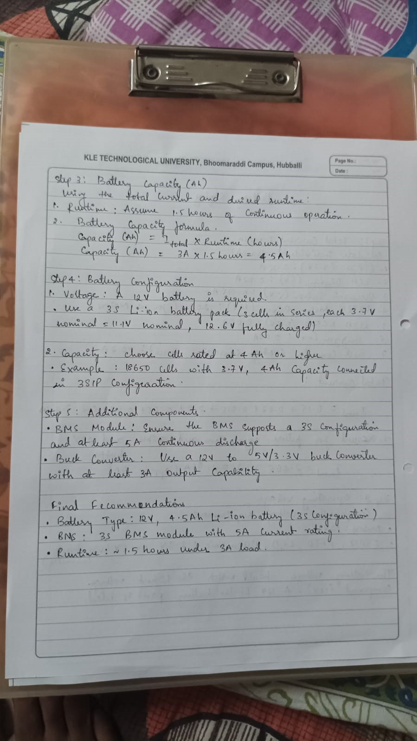
Electrical design

Slide 60
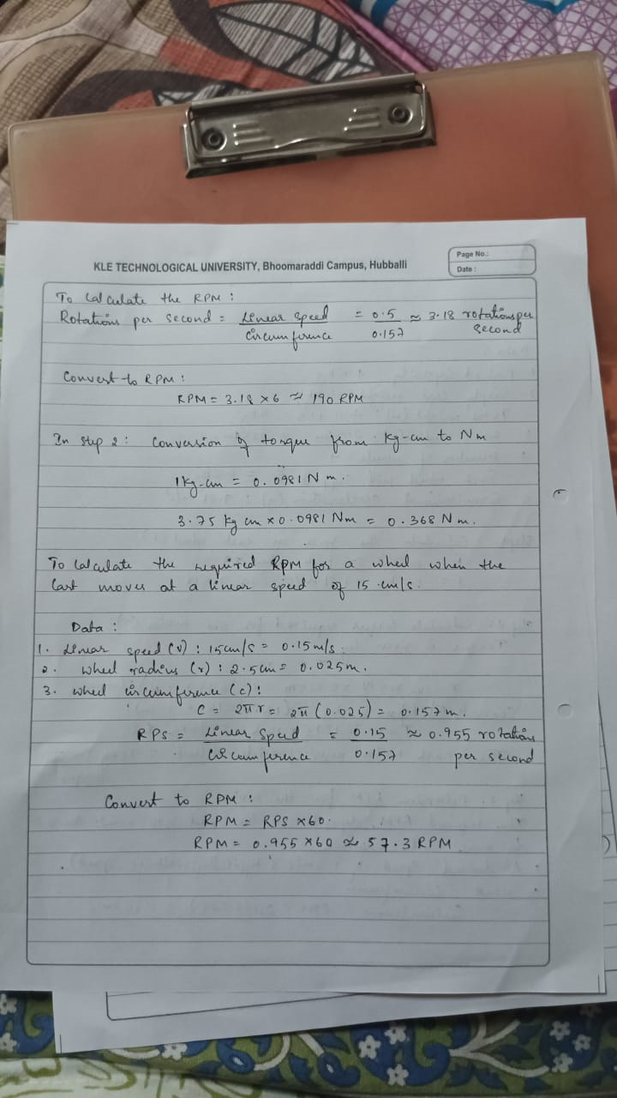
Electrical design

Slide 61
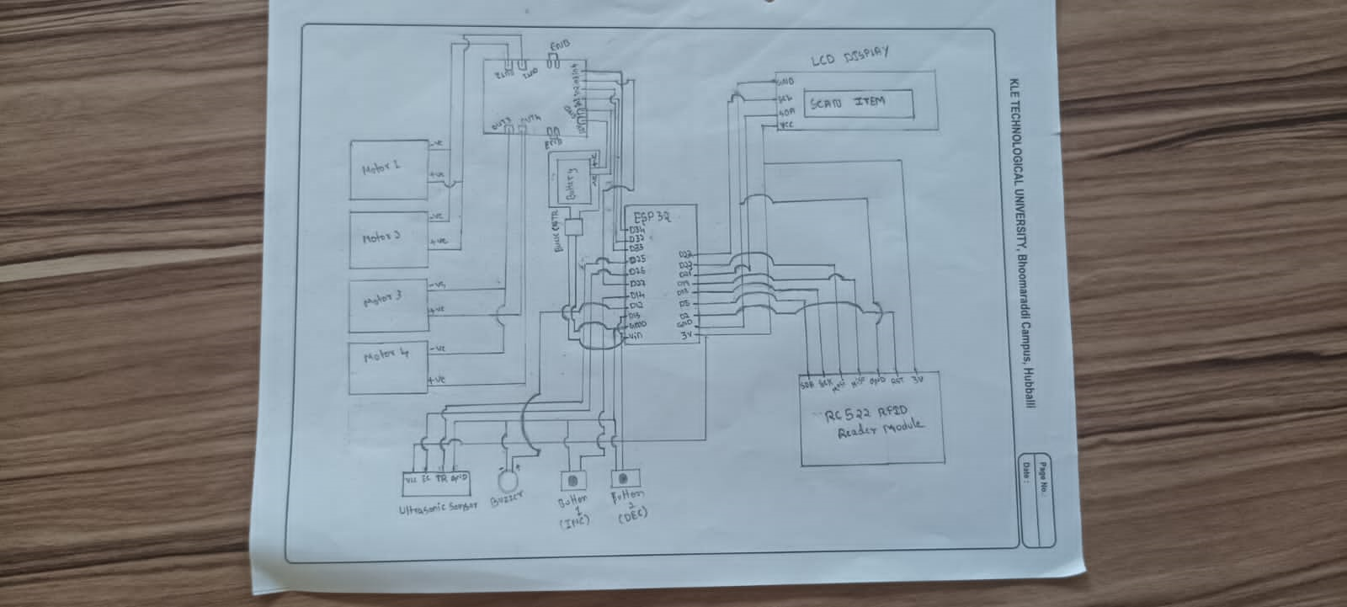
Electronics design

Slide 62
Prototype Realizing solutions

Slide 63
Insert your poster here.

Slide 64
Testing Seeking feedback

Slide 65
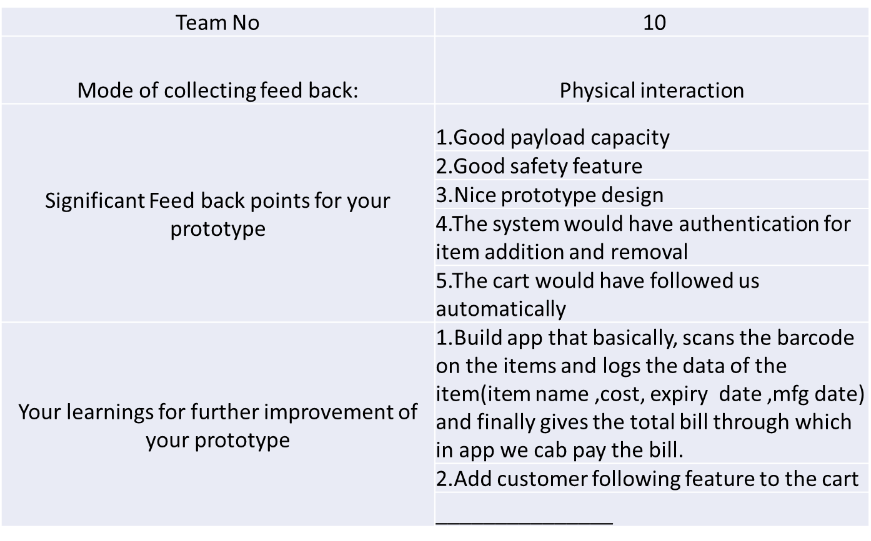
User feedback on prototype

Slide 66
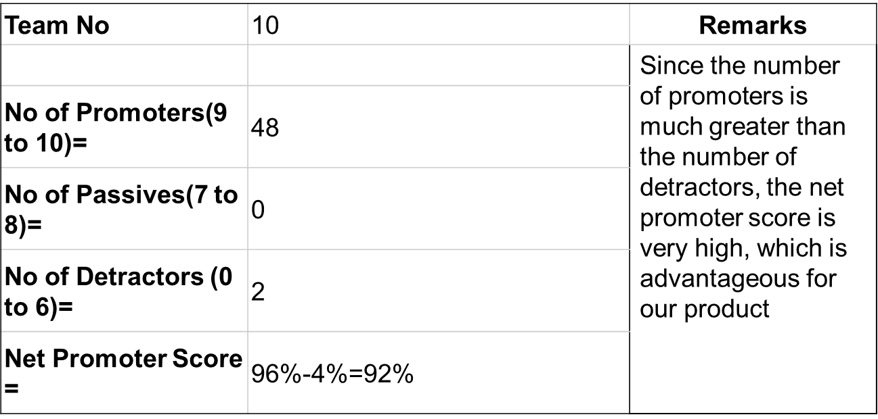
NPS Score

Slide 67
Verification & Validation
In developing our Smart Shopping Cart, we utilized various tools and technologies to meet the functional and design requirements. The verification and validation process ensures that the implemented system aligns with the defined objectives and specifications.
Autonomous Cart Movement
The cart is designed to move by controlling through application without manual pushing, ensuring smooth navigation. The structural design was carefully analyzed to support stability and movement across different surfaces.
Movement and Control
To achieve movement and avoid obstacles, we implemented a mobile application and ultrasonic sensor. The cart is capable of detecting its surroundings and stop if it detects any obstacle, ensuring efficient operation in crowded environments.
Automatic Billing System
The shopping cart integrates a smart billing mechanism that scans items as they are placed in the cart, reducing checkout time. This eliminates manual barcode scanning and enhances the shopping experience.

Slide 68
Verification & Validation
Safety Features
For secure operation, the cart includes real-time obstacle detection to prevent collisions. This ensures a safe shopping experience for users, particularly elderly and disabled customers.
Power Management
To ensure efficient power consumption, we analyzed the endurance requirements and integrated a suitable power source. The implemented power system provides optimal runtime for uninterrupted operation.
We successfully implemented the key requirements outlined in the project plan. The movement of the app through application, smart billing, safety mechanisms, and power management were effectively integrated into our prototype, validating the feasibility of the Smart Shopping Cart system.

Slide 69
Conclusion
In conclusion, the application of the VDI 2206 model played a crucial role in shaping our mechatronic system design. By following this structured approach, we systematically designed, implemented, and conceptualized our system, ensuring both functionality and efficiency.
Throughout this course, we gained valuable insights into the interdisciplinary nature of mechatronics, which seamlessly integrates mechanical, electrical, and computer engineering principles. Additionally, we explored the significance of various tools and techniques at different stages of development. From using SolidWorks for 3D modelling and other tools for simulation and circuit design, each tool enhanced our workflow, making the development process more efficient and structured.

Slide 70
THANK YOU

